Slide 1
Find all Hamiltonian Circuits assuming that the given graph is not complete
Yash Sharma - IHM2014006
Aditya Kumawat - ICM2014001
Shubham Vashishtha - IHM2014007

Slide 2
Overview
Proposed Methods to find all Hamiltonian Circuits for the graph which is not complete:-
Naive Approach
Using depth-first search Algorithm

Slide 3
Naive Approach
Check every one of the n! possible permutations of the vertices to see if things are joined up that way
N - no. of vertices
Adjacency Matrix ’A’ of size N x N
Matrix ‘P’ representing each vertex
Generate all possible permutations of matrix P
For every possible permutation, check if every adjacent vertices and starting and ending vertex are connected or not. If yes, given permutation is a Hamiltonian Circuit

Slide 4
Pseudo Code
find_circuit_using_permutation(adj_mat[n][n], n) {
for i = 0 to n-1 {
p[i]=i
}
hamiltonian_graph = false
do {
valid = true
for i = 0 to n-1 {
if adj[p[i]][p[(i+1) % n]] == false {
valid = false
break
}
}
if valid == true {
hamiltonian_graph = true
print(p)
}
} while(next_possible_permutation(p))
if hamiltonian_graph == false {
print(“no hamiltonian circuit exists”)
}
}
Time Complexity Analysis: O(N*N!)
Memory Usage Analysis: O(N^2)

Slide 5
Using Depth-first Search Algorithm
N - no. of vertices
Adjacency Matrix ’A’ of size N x N
Apply dfs starting from every vertex v and start labelling them as :
“IN STACK” : If its visited but some of its adjacent vertices are not yet visited.
“NOT IN STACK”. : If its not visited.
If at any point of time, no. of vertices with label “IN STACK” equals to N, then a Hamiltonian Circuit exists in graph.

Slide 6
Pseudo Code
bool dfs(adj_mat[][], label[], n, stack) {
if stack.size == n && adj[stack.top][stack.bottom]
then print(stack)
return true
v = stack.top
for i = 1 to n {
if (adj[v][i] && label[i]==NOT_IN_STACK)
then label[i] = IN_STACK
stack.push(i)
dfs(adj_mat, label, n, stack)
label[i] = NOT_IN_STACK
stack.pop()
}
return false
}
find_circuit_using_dfs(adj_mat[n][n], n) {
for i = 1 to n {
label[i] = NOT_IN_STACK
}
for i = 1 to n {
label[i] = IN_STACK
stack.push(i)
if dfs(adj_mat, label, n, stack) is true
then print(stack)
label[i] = NOT_IN_STACK
stack.pop()
}
}
Time Complexity : Worst case complexity of using DFS and backtracking is O(N!).
Memory Usage Analysis: O(N)

Slide 7
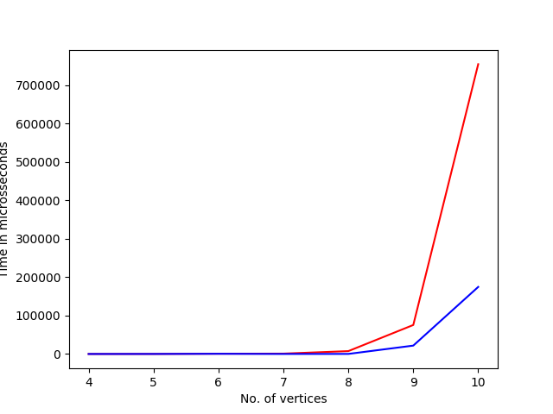
Results
Y - Axis : number of vertices in the graph.
X - Axis : represents the time taken (in microseconds) to find all the Hamiltonian circuits in the graph.
Red Curve : Time taken by the naive approach.
Blue Curve : Time taken by the approach with DFS & Backtracking.

Slide 8
Conclusion
No good algorithm known to find a Hamilton circuit. NP-Complete problem.
Most obvious way is to check every one of the n! possible permutations of the vertices to see if things are joined up that way.
Some of the known algorithms are of exponential order which check for existence of Hamiltonian Cycle. They don’t scale very well for very large graphs upto 20 vertices.
Proof of non-existence of non-exponential algorithms doesn’t exist either.

